Slide 1

EIE 2001 Basic Circuit Theory
Lecture 6
RLC Second-order Circuits

Slide 2
Overview
The previous chapter introduced the concept of first order circuits.
This chapter looks into second order circuits.
When the circuits contain both Capacitor and Inductor (RLC circuits), the response needs to be expressed as a second order differential equation.
  RLC series and parallel circuits; natural response
  Step response

Slide 3
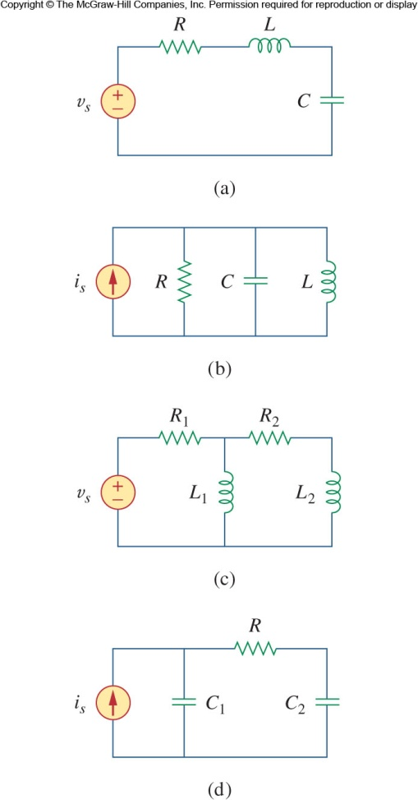
Second Order Circuits
RC or RL circuits only require first order differential equations to solve.
But when more than one “storage element”, i.e. multiple capacitors or inductors are present, the response require higher order differential equations to solve.
A second-order circuit is characterized by a second-order differential equation. It consists of resistors and the equivalent of two energy storage elements.
Here we will only consider DC independent sources for the second order circuits.

Slide 4
RLC Circuits Analysis
The analysis is similar to the first order circuits, we will still start with source free response analysis, then response analysis with external power source.
Identify the variable of interest: i_{L}(t) for inductor, v_{C}(t) for capacitor
  Setting the voltage polarity across a capacitor and the direction of current through an inductor is critical.
  Remember that capacitor voltage and inductor current are always continuous.
Determine the initial value of the variable(s)
  Working on second order system is harder than first order in terms of finding initial and final conditions.
  Need to know the initial values for derivatives, dv/dt or di/dt.

Slide 5
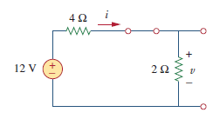
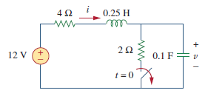
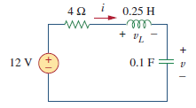

Example 1
t=0 ⁻
t=0⁺

Slide 6
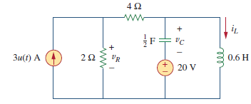
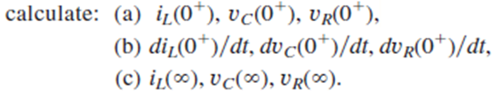
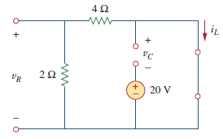
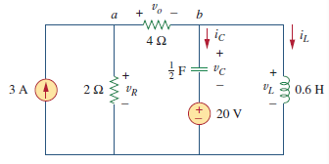
Example 2
t=0 ⁻
t=0⁺

Slide 7
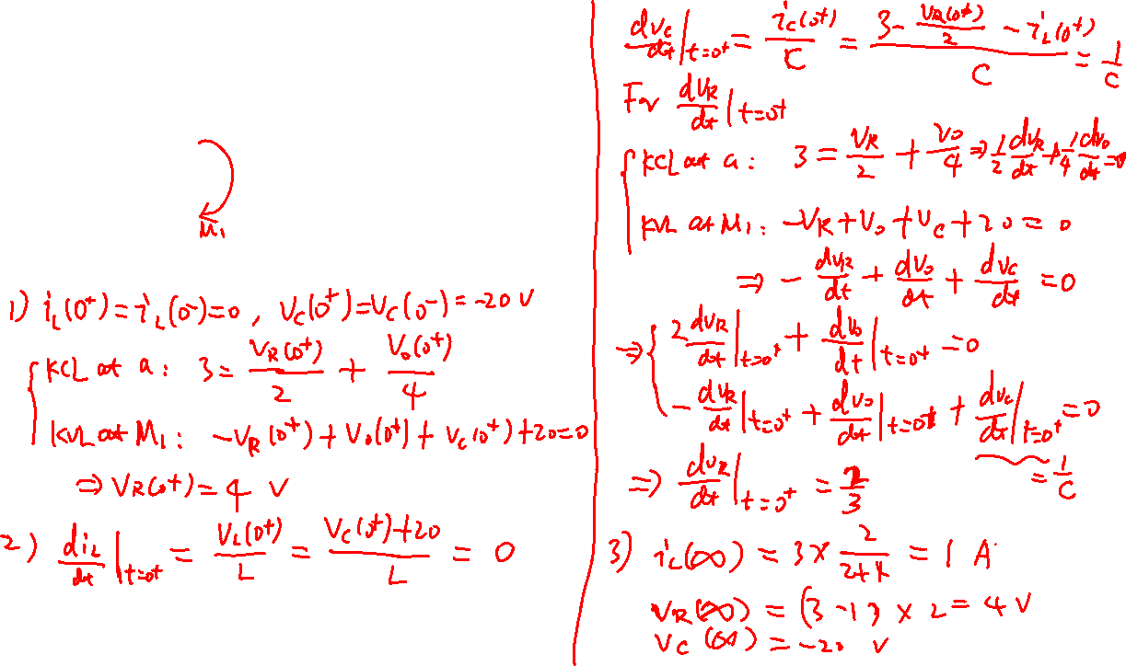

Slide 8
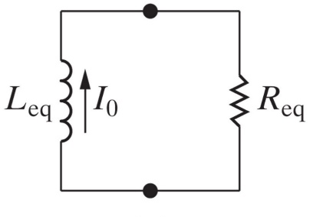


Recall the Response of RL/RC Circuits
RL Circuits
RC Circuits
Time Constant
Natural Response
Step Response
Steady State
Response
Transient Response
（same form as Natural Response)

Slide 9
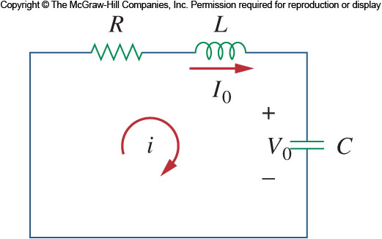
Source Free Series RLC
Source free, inductor and capacitor in series connection.
Assume at t=0, the energy is stored in the capacitor, represented by V₀ and in the inductor, represented by I₀.
Applying KVL around the loop
Differentiating gives a second order equation
Initial condition

Slide 10
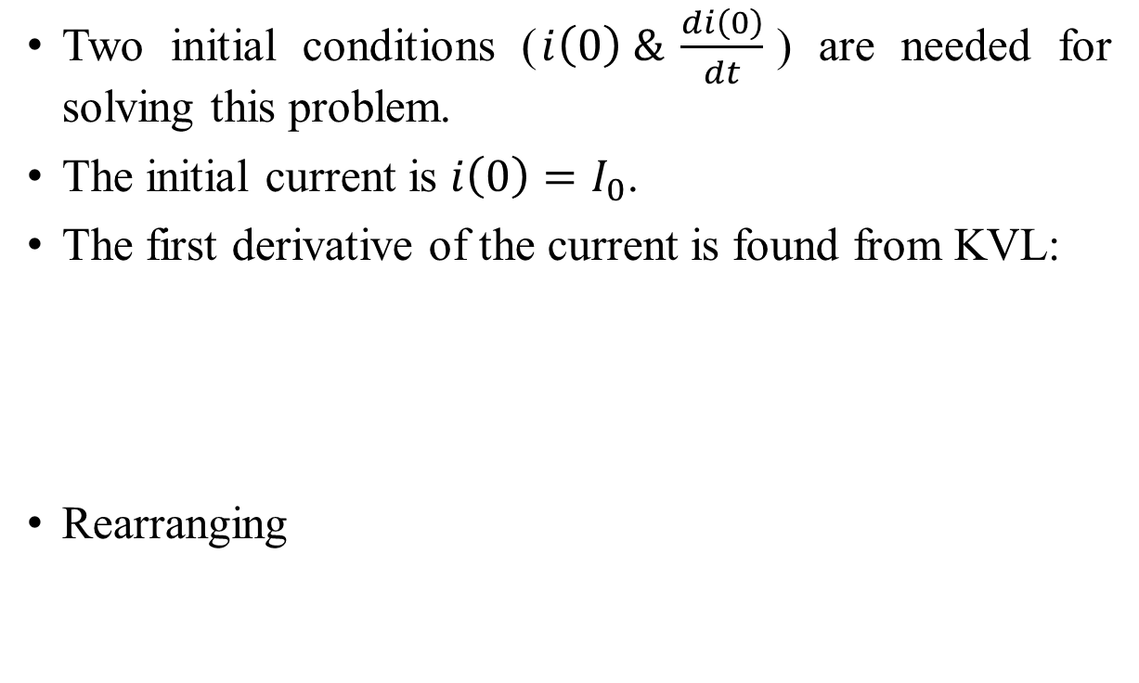
Source Free Series RLC – Initial Values
Two initial conditions ($i\left(0\right) \& \frac{di\left(0\right)}{dt}$) are needed for solving this problem.
The initial current is $i\left(0\right)=I_{0}$.
The first derivative of the current is found from KVL:
Rearranging
Remark: I₀, V₀ and 𝑑𝑖(0)/𝑑𝑡 CANNOT ALL be independently specified. Only two of the three can.

Slide 11

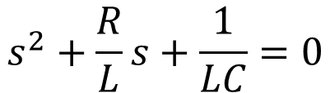
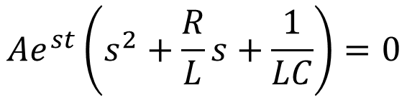
Source Free Series RLC
Based on the first order solutions, we can expect that the solution is of exponential form. So we let , where A and s are constants to be determined.
Substitute into the second order differential equation
we obtain
In this equation, only the expression in parentheses can be zero.
Two roots of the characteristic equation are
$$Ae^{st}\left(s^{2}+\frac{R}{L}s+\frac{1}{LC}\right)=0$$
$$s^{2}+\frac{R}{L}s+\frac{1}{LC}=0$$
This is known as the characteristic equation of the differential equation

Slide 12
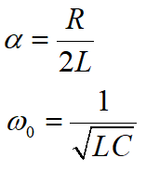
Source Free Series RLC
A more compact way of expression is
Let
The characteristic equation to solve becomes:
For which the solutions are:

Slide 13
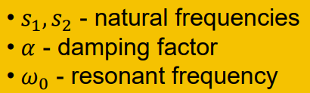




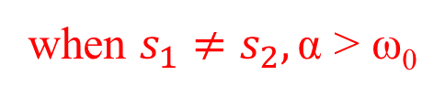
Solutions of the second order ODE
Units: rad/s
Any i of the form , where s satisfies the characteristic equation of the ODE. As there are two such i’s, each of them is a solution.
By superposition, a linear combination of them is also a solution. The general solution of the ODE is
where A₁ and A₂ are constants to be determined by initial conditions, recall that
when $s_{1}≠s_{2},\text{α}\text{ > }\text{ω}\text{0}$

Slide 14
Characteristic Equation of 2nd Order System
For a second-order system, the characteristic equation is
Three type of solutions to discuss, depending on the value of

Slide 15
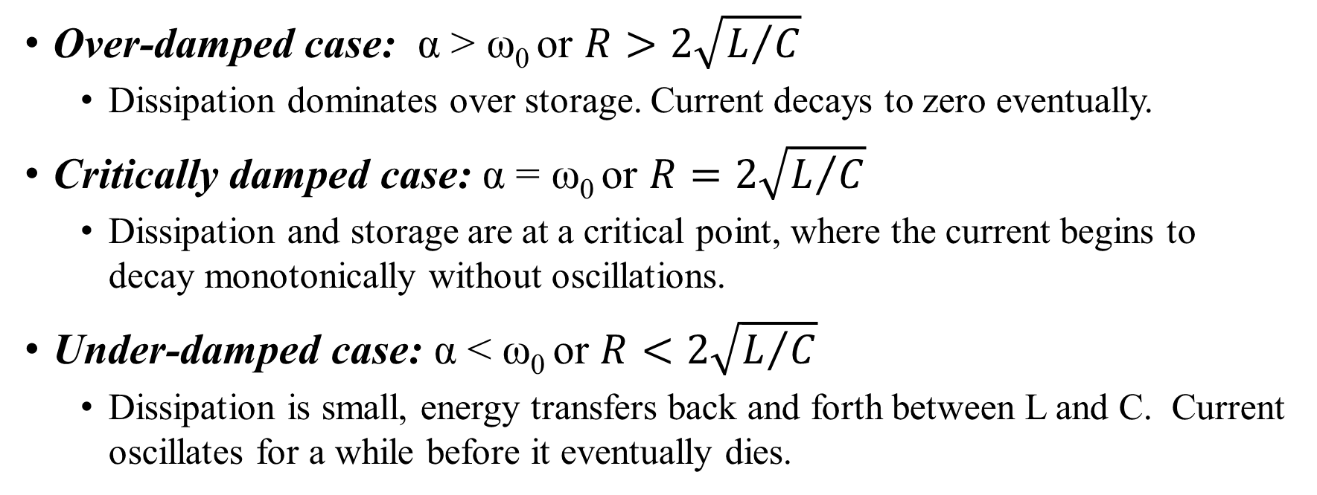
Over-damped case: α > ω₀ or $R>2\sqrt{L/C}$
  Dissipation dominates over storage. Current decays to zero eventually.
Critically damped case: α = ω₀ or $R=2\sqrt{L/C}$
  Dissipation and storage are at a critical point, where the current begins to decay monotonically without oscillations.
Under-damped case: α < ω₀ or $R<2\sqrt{L/C}$
  Dissipation is small, energy transfers back and forth between L and C. Current oscillates for a while before it eventually dies.

Slide 16
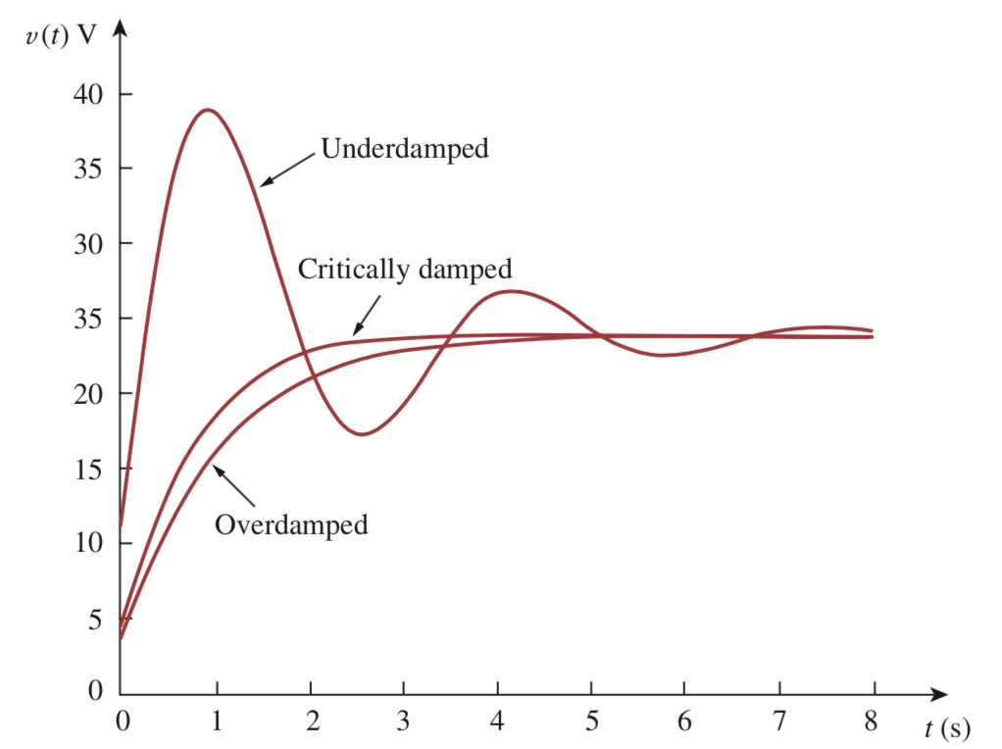
Critically damped system is the quickest to reach the steady state

Slide 17


Solutions of the second order ODE
Over-damped case (α > ω₀)
Both s₁ and s₂ are real and negative.
The response of the system is:
It decays and approaches zero as t increases.

Slide 18
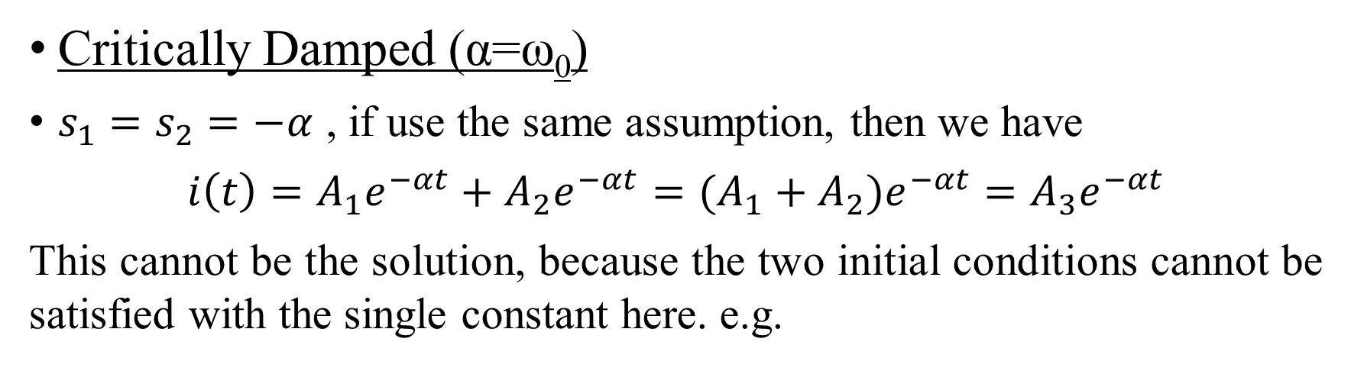
Solutions of the second order ODE
Critically Damped (α=ω₀)
$s_{1}=s_{2}=−α$ , if use the same assumption, then we have
$i\left(t\right)=A_{1}e^{−αt}+A_{2}e^{−αt}=(A_{1}+A_{2}{)e}^{−αt}=A_{3}e^{−αt}$
This cannot be the solution, because the two initial conditions cannot be satisfied with the single constant here. e.g.
So what is the problem?

Slide 19
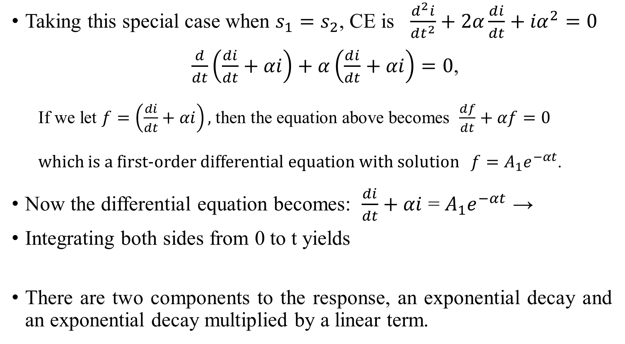
Taking this special case when $s_{1}=s_{2}$, CE is $\frac{d^{2}i}{dt^{2}}+2α\frac{di}{dt}+{iα}^{2}=0$
  $\frac{d}{dt}\left(\frac{di}{dt}+αi\right)+α\left(\frac{di}{dt}+αi\right)=0$,
  If we let $f=\left(\frac{di}{dt}+αi\right),$ then the equation above becomes $\frac{df}{dt}+αf=0$
  which is a first-order differential equation with solution $f=A_{1}e^{−αt}$.
Now the differential equation becomes: $\frac{di}{dt}+αi$ = $A_{1}e^{−αt}$ →
Integrating both sides from 0 to t yields
There are two components to the response, an exponential decay and an exponential decay multiplied by a linear term.

Slide 20

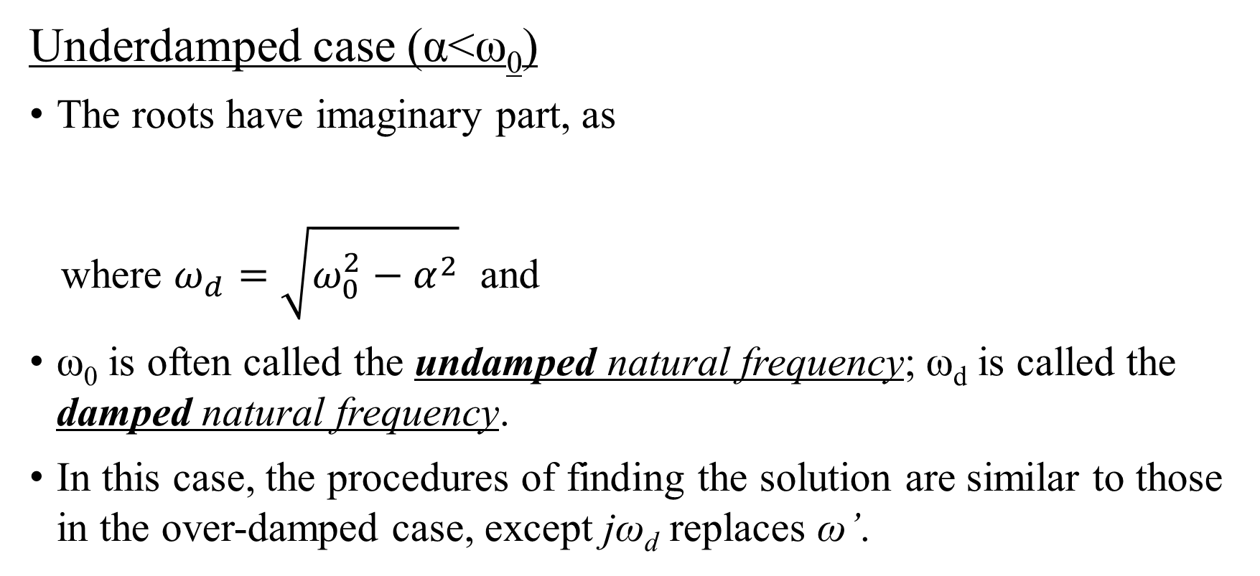
Solutions of the second order ODE
Underdamped case (α<ω₀)
The roots have imaginary part, as
where $ω_{d}=\sqrt{ω_{0}^{2}−α^{2}}$ and
ω₀ is often called the undamped natural frequency; ω_{d} is called the damped natural frequency.
In this case, the procedures of finding the solution are similar to those in the over-damped case, except jω_{d} replaces ω’.

Slide 21
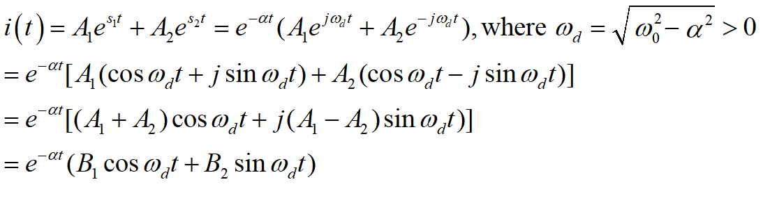
The natural response is
Remark: i is real and oscillatory with an angular frequency ω_{d} , though it appears complex in the expression above; but actually the constant
A1 and A2 are taken as complex conjugate
B1 and B2 are real.

Slide 22
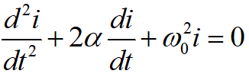
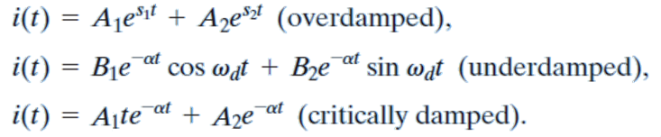

Solutions of the second order ODE
For a second order differential equation
The C.E. is
And the general solution will be in the form of
α > ω₀
α < ω₀
α = ω₀

Slide 23






Source Free Series RLC
Now let’s look back at the source free series RLC
By adjusting the value of 𝑅, response may be made
  Undamped (R=0),
  Underdamped
  Critically damped
  Overdamped.
$$=\frac{1}{2τ_{RL}}$$
$$α⟷ω$$
$$R⟷2\sqrt{\frac{L}{C}}$$
($R<2\sqrt{L/C})$
($R=2\sqrt{L/C})$
($R>2\sqrt{L/C})$

Slide 24
Damping and RLC networks
RLC networks can be characterized by the following:
The behavior of these networks is captured by the idea of damping.
Oscillatory response is possible due to the presence of two types of energy storage elements. L and C allows the flow of energy back and forth between the two.
It is typically difficult to tell the difference between overdamped and critically damped responses.
  Critically damped response is the borderline between the other two, and it decays the fastest.
  With the same initial conditions, the overdamped case has longer settling time.

Slide 25
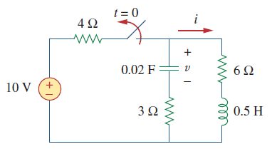

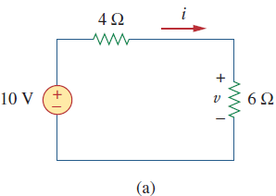
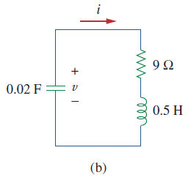
Example 3
Find i(t) in the circuit, assume the switch opens at t=0.
t <0, C is open and L is short. Voltage across C and
current through L are those across and through R in (a)
Initial conditions: from (a)
t>0, the circuit to consider is (b)
The characteristic roots are complex and i(t) is under-damped
t=0 ⁻
t=0⁺

Slide 26

Example 3 (cont’d)
The two characteristic roots are:
And the current is:

Slide 27
Example 3 (cont’d)
Initial conditions
The final form of the current is

Slide 28
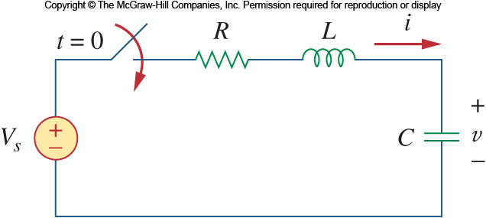

Step Response of a Series RLC Circuit
Now let us consider what happens when a DC voltage is suddenly applied to a second order circuit.
Consider the circuit shown. The switch closes at t=0.
Applying KVL around the loop for t>0:
Substituting for i gives:
This is similar to the response for the source free version of the series circuit, except the variable is different, and the RHS is not zero.

Slide 29
Step Response of a Series RLC Circuit
Recall in the first-order circuit, for the step response, we can break it up into the transient response and steady state response. Here we can do the same.
The solution to this equation is a combination of transient response and steady state
  The transient response v_{t}(t) is in the same form as the solutions for the source free version.
  The steady state v_{ss}(t) is the value of v(t→∞). In series RLC, the capacitor voltage will equal the source voltage.

Slide 30



Step Response of a Series RLC Circuit
The complete solutions for the three conditions of damping are:
The variables A₁ and A₂ are obtained from the initial conditions, v(0) and dv(0)/dt.

Slide 31
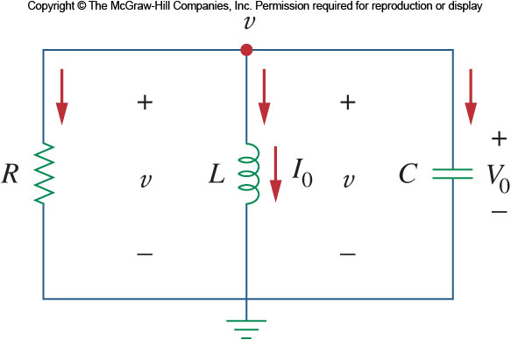
Source Free Parallel RLC – Initial Values
Now let us look at parallel forms of RLC circuit as shown here
Assume the initial current and voltage to be:
We also need to know the first derivative of the voltage dv(0)/dt.
Apply KCL at top node,

Slide 32
Source Free Parallel RLC Circuit
Applying KCL to the top node we get:
Taking the derivative with respect to t gives:
Remark: second order ODE of the same form as that obtained in series RLC, but v replaces i and the constants are different.
The characteristic equation for this is:

Slide 33
Source Free Parallel RLC Circuit
From this, we can find the roots of the characteristic equation to be:
As in series RLC network, there are three scenarios to consider.

Slide 34
For the overdamped case, the roots are real and negative, so the response is:
For the critically damped, the roots are real and equal, so the response is:
For the under-damped case, the roots are complex and so the response will be:
where

Slide 35
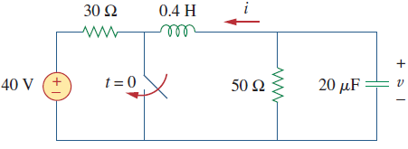



Example 4
At t=0, switch closes, find v_{c}(t)
For t<0, L short and C open circuit.
Initial conditions:
Parallel RLC circuit C.E. is , the roots are

Slide 36
Example 4 (cont’d)
Both roots are real, the response is over-damped.
The solution of the ODE is of the form:
and
A₁ & A₂ satisfy the initial conditions
Finally,

Slide 37

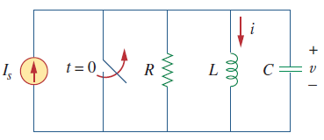
Step Response of a Parallel RLC Circuit
The same treatment given to the parallel RLC circuit yields the same result.
The response is a combination of transient and
steady state responses:
Here the variables A₁ and A₂ are obtained from the initial conditions, i(0) and di(0)/dt.
Note that the transient response is of the same from as source-free response (but with different constants A₁ and A₂)

Slide 38
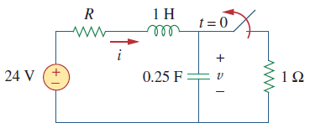

Example 5
Find v(t) and i(t) for t>0 and different R values.
Three cases: R=(5,4,1)Ω.
For t<0, inductor short; and capacitor open.
At t=0⁺,
Since the current of an inductor is continuous,
To find the characteristic roots, consider
(4,4.8,12)
(4,4.8,12)V
(16,19.2,48) V/s

Slide 39
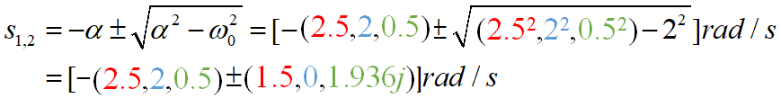
Example 5 (cont’d)
The roots are
Case 1: both roots are real and different
  The response is over-damped
  At steady state, the transients die out, so
  Initial conditions:
  The response is

Slide 40
Example 5 (cont’d)
Case 2: the roots are real and equal
  The response is critically-damped
  At steady state, the transients die out, so
  Initial conditions:
  The response is

Slide 41
Example 5 (cont’d)
Case 3: The roots are complex
  The response is under-damped and has the form
  Initial conditions
  The response is

Slide 42
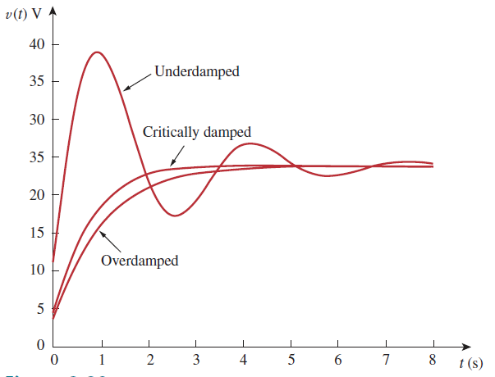
Example 5 (cont’d)
R gives rise to damping of oscillations by dissipating energy. The larger the dissipation, the greater the damping.
Plots of the three responses
R=5Ω, over-damped
R=4Ω, critically damped
R=1Ω, under-damped
Note: the initial overshoot for the under-damped response.

Slide 43
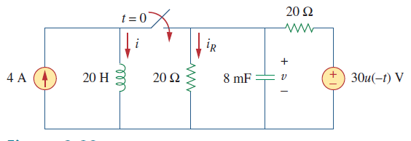
Example 6
For t<0, the switch is open, and the circuit is partitioned into two
u(-t)=1, the capacitor is open and inductor short
For t>0, switch close and u(-t)= 0.
The circuit is that of parallel RLC charged
by a 4A current source (Voltage source not operative).
The two 20 Ω resistors are equivalent to R=20//20 Ω =10 Ω.
To determine the characteristic roots consider:

Slide 44
Example 6 (cont’d)
The roots are:
both real and negative. The response is thus over-damped.
The solution to the ODE is of the form:
In steady state, the transient currents die out :
Constants A₁ and A₂ must satisfy the initial conditions:

Slide 45
Example 6 (cont’d)
The final form of the current is:
The voltage on the inductor, resistors and capacitor is
The current through each of the resistors is

Slide 46
General Second Order Circuits (beyond RLC)
The principles of the approach to solving the series and parallel forms of RLC circuits can be applied to second order circuits in general. The following four steps need to be taken:
First determine the initial conditions, x(0) and dx(0)/dt.
Turn off the independent sources and find the form of the transient response by applying KVL and KCL: by observing the ODE to obtain the form of , keeping the unknown constants.
We obtain the steady state response as:
where x(∞) is the final value of x obtained in step 1
The total response is now found as the sum of the transient response and steady-state response
The unknown constants in x(t) will be found from initial conditions.

Slide 47
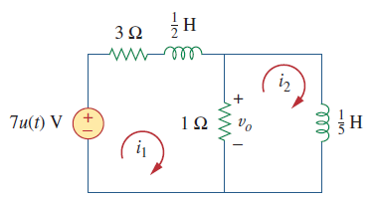
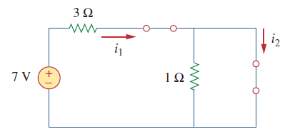
Example 7
Second order circuit with two inductors
For t<0, the voltage source is short
Due to the continuity of inductor current
KVL At t=0⁺,
Similarly,
At t→∞ (steady state), both inductors short out;
steady state

Slide 48
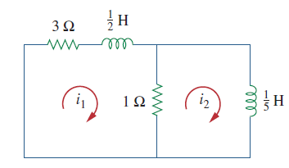
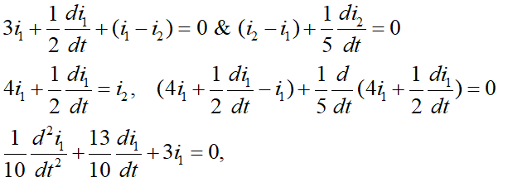

Example 7
Source free (natural) response:
Short the voltage source, the circuit becomes
KVL yields
A second order ODE for i_{1.}

Slide 49

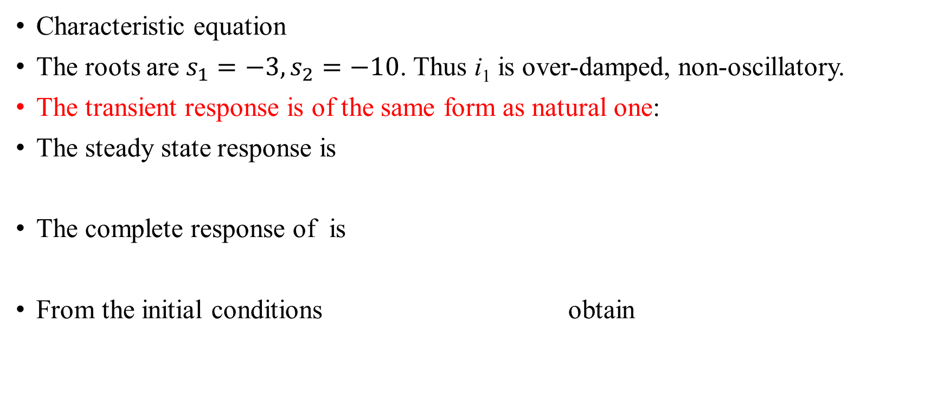
Example 7
Characteristic equation
The roots are $s_{1}=−3, s_{2}=−10$. Thus i₁ is over-damped, non-oscillatory.
The transient response is of the same form as natural one:
The steady state response is
The complete response of is
From the initial conditions obtain

Slide 50
Example 7
The complete response for i₁ is thus
The complete response for i₂ is obtained from applying KVL to the left loop of the original circuit.
Voltage across the 1 Ω resistor is

Slide 51
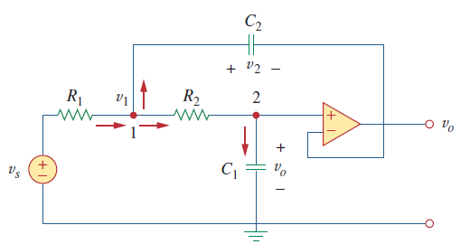
Example: second order op-amp circuit
An op-amp circuit with two storage elements that cannot be combined into a single equivalent element is also second order, just like the previous example.
Note: the op-amp is wired as a voltage follower.
Apply KCL to nodes 1 & 2,
where .
Eliminate v₁ and v₂, to obtain
which is a second order ODE in v_{o}.

Slide 52


Example: second order op-amp circuit
For the case where v_{s} =V_{s}u(t) (a DC source).
Characteristic equation to solve
The final form of v_{o}(t) depends on the values of the circuit parameters.
Its constants are determined from:
Initial conditions
  For t < 0, v_{s} =0,
  For t > 0, v_{s} =V_{s},
In the steady state, the capacitors are open

Slide 53
Expected learning outcome
Be able to formulate and solve second-order ODEs for series and parallel RLC and other second-order circuits
  Be able to find the initial conditions (zero-order and first-order initial condition for the variable of interest)
  Be able to find the characteristic function and discuss the types of roots
Understand how different circuit parameters lead to overdamped, critically damped, and underdamped systems

Slide 54
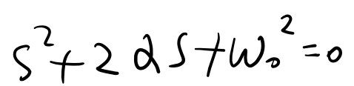
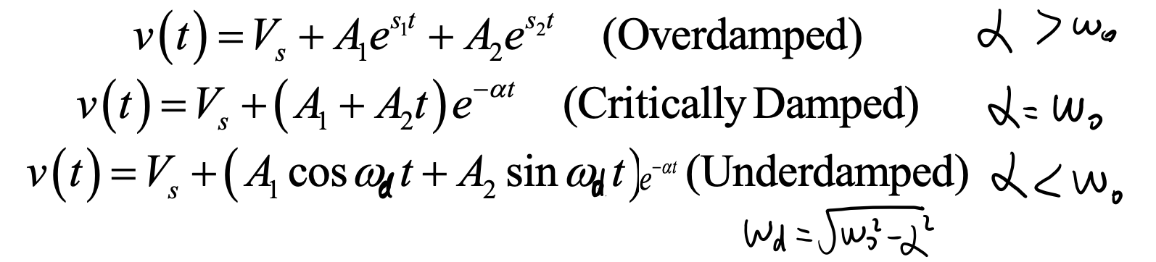
Key contents
Pick a voltage or current as the variable
Solve intitial values for the variable or its derivative
For RLC in series or in parallel
  Total response=Steady-State Response + Transient Response
  Transient Resposne=Natural (Source-Free) Responses; one of the three forms
  Steady-State Response: final value for voltage/current
  Use initial values pair to solve the two unknown constants
For general 2nd-order circuit: pick a voltage or current as the variable
  Total response=Steady-State Response + Transient Response
  Transient Resposne=Natural (Source-Free) Responses
  Disable all the independent sources; Apply KVL/KCL to get a 2nd-order ODE for the variable; write out the characteric equation:
  The transient response:

